Slide 1

TURNING TERRITORIAL COMPLEXITY INTO ACTIONNABLE INSIGHTS

Slide 2
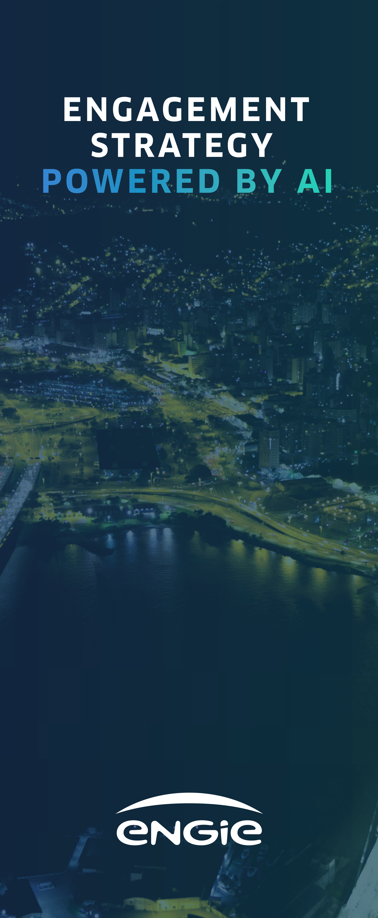



Context
Asset-based projects face growing complexity in local environments
When projects take root, they interact with a dense local ecosystem: institutions, associations, citizens, industries.
Acceptance and implementation depend on how well ENGIE understands these dynamics.
Stakeholder Suite provides structured territorial intelligence across projects and regions.
10+ pilot projects
7 years of data collected
>1000 stakeholders mapped

Slide 3
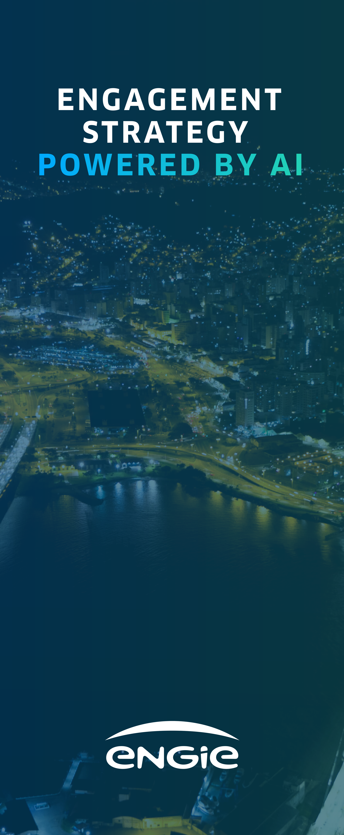
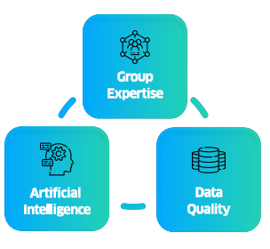
Challenges
Fragmented information, invisible dynamics
Stakeholder Suite centralizes fragmented information about stakeholders, debates, and local contexts into a single AI-powered platform.
~20,000 paragraphs
analyzed per project
50% time saved
on synthesis vs manual review

Slide 4

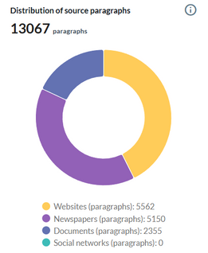
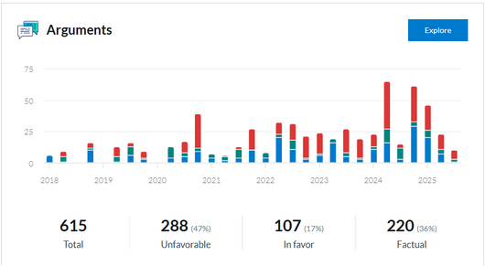
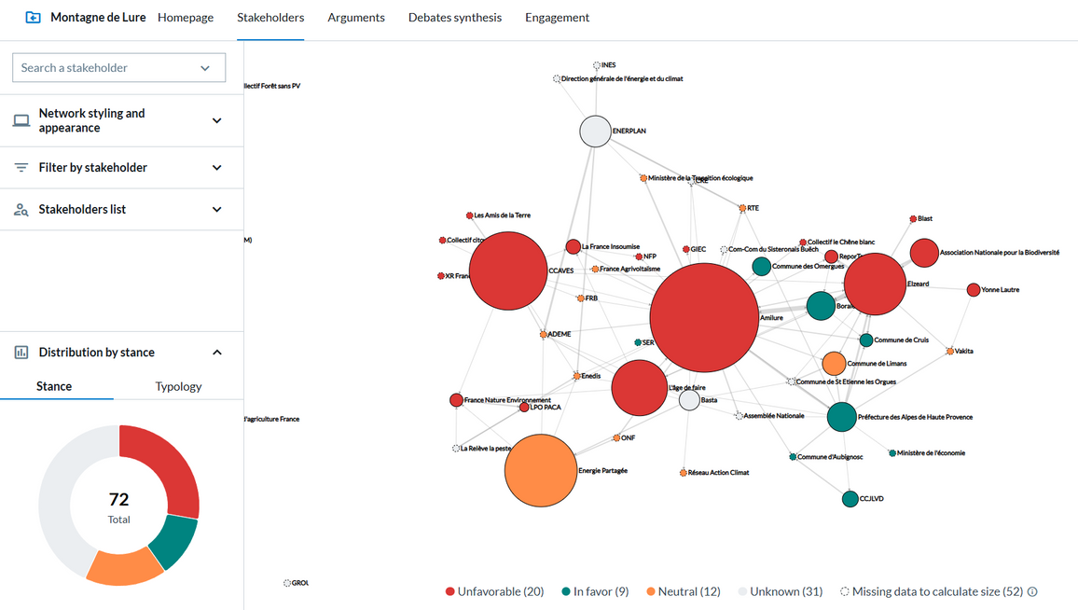
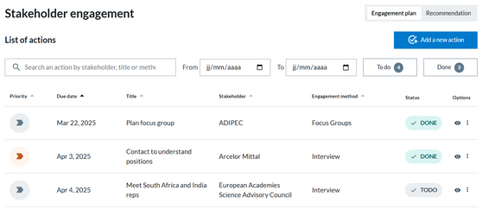
A modular suite for stakeholder intelligence
📚 Data Patrimony
Foundation
💬 Arguments
Insights
🌐 Stakeholders
Ecosystem
🤝 Engagement
Action
View AI-generated arguments, topics, stances
Map and analyze the stakeholder network
Manage and track an intelligent engagement plan
Collect, organize, and enrich data sources
A comprehensive base combining documents, stakeholders, and clustered themes: the foundation for all AI analysis.
Extracts, classifies, and filters arguments from thousands of documents to reveal key narratives and actors’ positions.
Visualizes influence, typologies, and interconnections showing who matters most and how actors relate across sources.
Transforms analysis into engagement plans and follow-up actions, enabling expert-guided stakeholder strategies.
One suite, from AI analysis to stakeholder action.

Slide 5
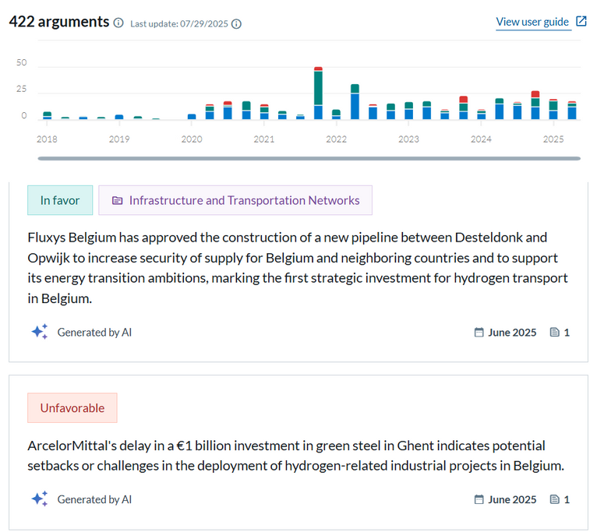
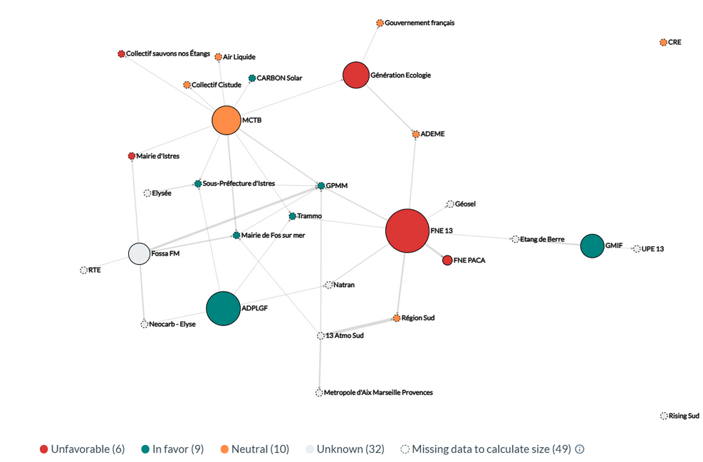
Understand & Visualize
Decypher narratives and stakeholders networks
Stakeholder Suite combines AI-based text analysis and stakeholder mapping to help project teams anticipate tensions, detect coalitions, and build informed engagement strategies.

Slide 6
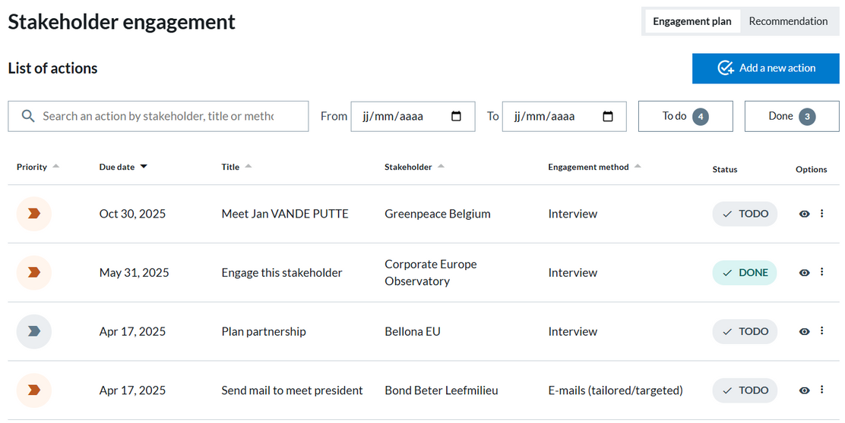
Engage
From data to dialogue
Stakeholder Suite turns insights into action by guiding engagement strategies.
Plan meetings
Adapt communication
Coordinate actions
Track all interactions for consistent dialogue
Expert-designed, ready-to-use engagement plans
Built with experts and adapted to specific technologies, to guide project owners in stakeholder dialogue

Slide 7


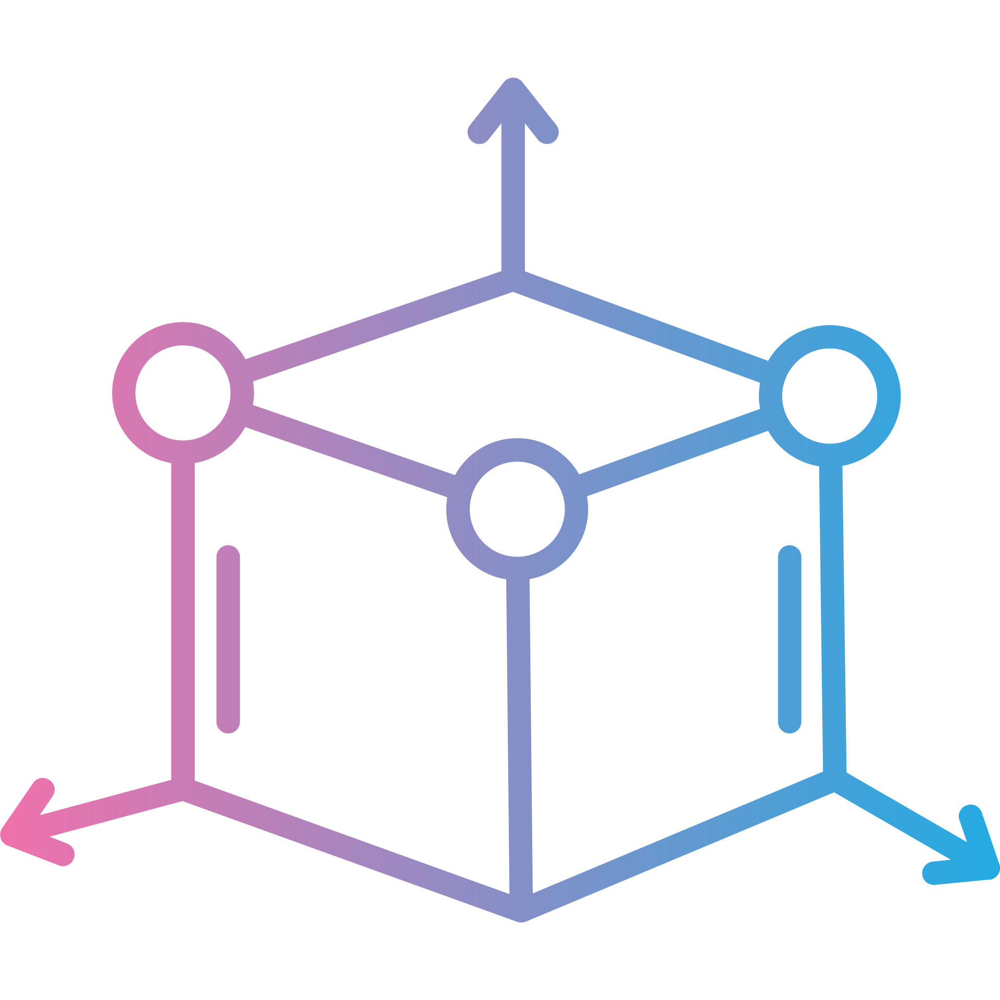

Powered by advanced AI and data visualization technologies
Behind Stakeholder Suite lies a robust tech stack combining artificial intelligence, natural language processing, and interactive visualization.
Data layer
NLP & AI Layer
Modeling Layer
Vizualisation Layer
Semantic retrieval & clustering
OpenSearch • HDBSCAN • Spectral clustering
Entity, argument & topic extraction
FLAIR • LLMs (GPT-4o, Azure) • RAG
Similarity & stance detection
Cosine similarity • MMR ranking
Interactive dashboards & maps
Plotly • D3.js

Slide 8
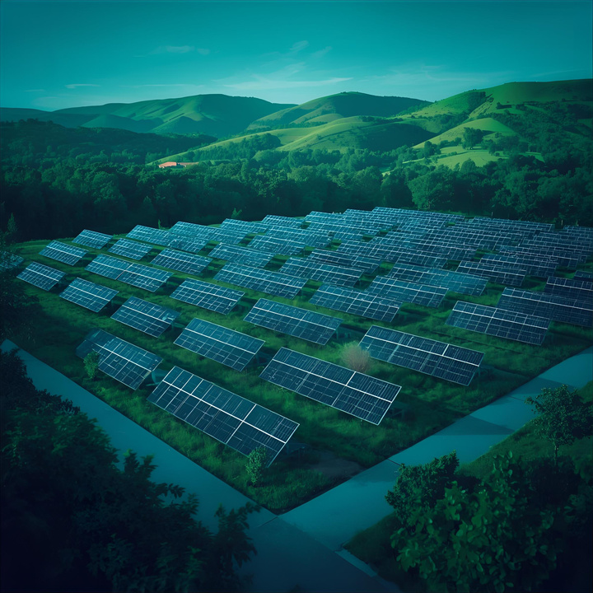


Use case | Various solar projects on a same area
Managing controversy through knowledge and narrative intelligence
Project teams needed to understand the roots of local opposition, identify legitimate environmental arguments, and spot potential allies to anticipate future debates.
72
stakeholders tracked
22
detected & suggested by our models
Stakeholder helped us make sense of a very polarized local context. We could clearly see who was opposing the project, why, and which associations were driving the debate.
615
arguments analyzed

Slide 9



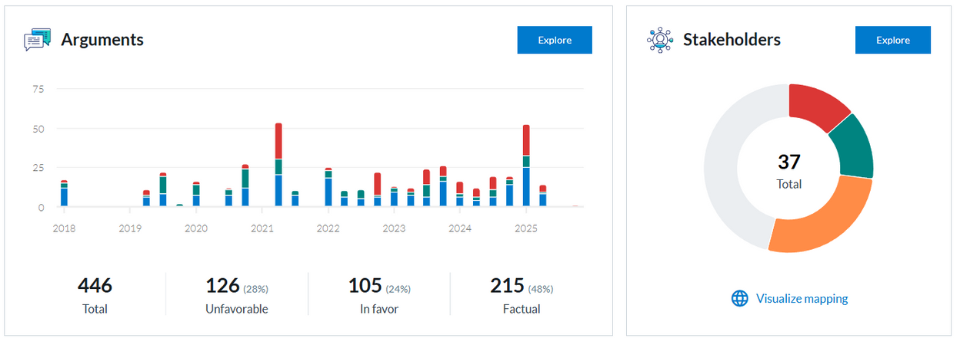
Use case | Various onshore projects in a rural area
Understanding local perceptions to prepare transparent dialogue
Given the strong emotional charge of wind energy debates in rural regions, project teams needed a clear view of how residents and associations express their positions
The tool helped us understand how local debates evolve across nearby wind projects — we could anticipate concerns and adapt our dialogue before going public.
37
stakeholders tracked
208
local docs collected
446
arguments analyzed

Slide 10
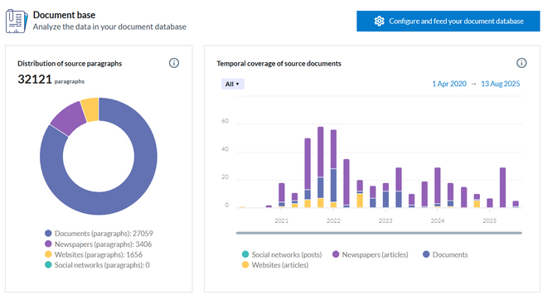
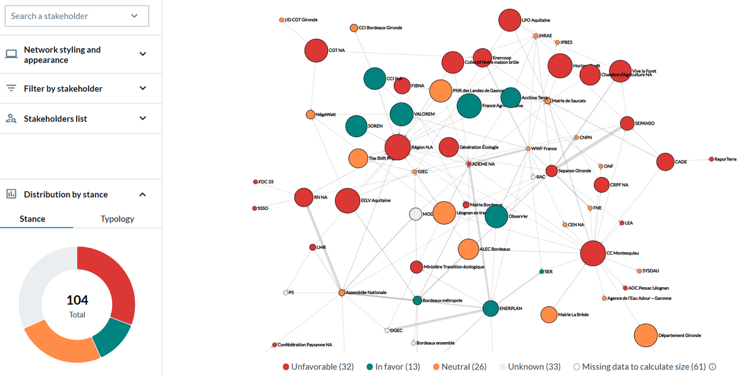
Use case | One large solar project
From public debate to strategic insight: learning from one of Europe’s largest PV projects
After the 2022–2023 public debate led by the CNDP, ENGIE teams needed to analyze the thousands of contributions and press reactions to understand how the project was perceived.
104
stakeholders tracked
+32000
paragraphs analyzed
1010
arguments extracted
Stakeholder gives us a long-term view — we can see how the narrative around Horizeo has changed, and how local debates connect with national energy policy.

Slide 11











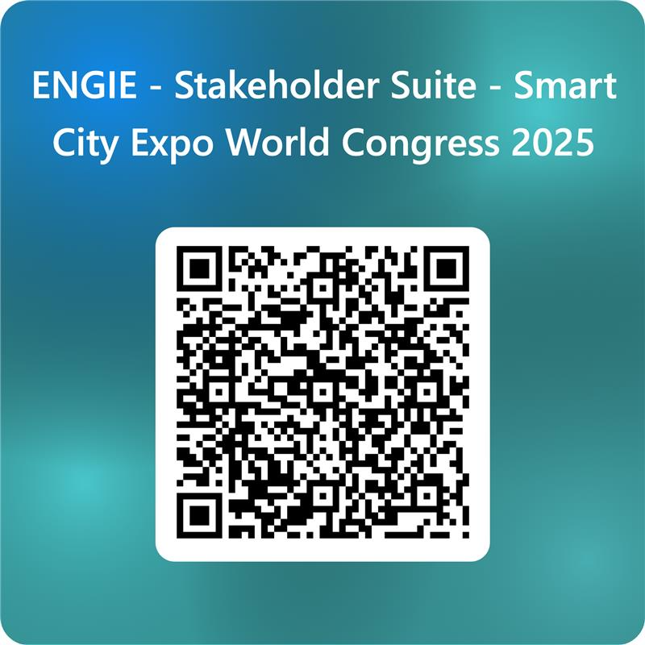
Thank
you!

